Slide 1
Titanic Machine Learning from Disaster: Classification model investigation
Deirdre Boland 14 Feb 2024

Slide 2
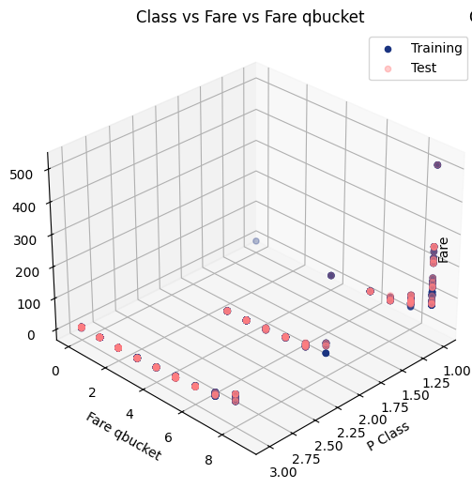
Objective and dataset
Objectives
Fit Logistic Regression model to Titanic – Machine Learning from Disaster Kaggle competition data and measure accuracy.
Compare performance of different classifier, not focussed on optimising for accuracy due to time limits
Data Preparation
Cabin data had too many null values and ticket too many unique values to be useful - not used
Likely to vary between datasets which may be issue for model reuse, test transformation
Sex was label encoded to binary (male = 1, female = 0)
Embarked null values filled with “S” (most frequent) and label encoded to 0-2
Age data investigation - Women and children first
Lot of null age data
generated new feature Child/Adult by decomposing Name and looking at Parent child (Parch) relationship and label encoded
child female – 0, child male - 1, adult female - 2, adult male -3
Age null filled with median and alternate using child/adult data to assign more appropriate age
Minimal difference due to small population of children
Fare had some null data but also some zero values
Zero values - Traced back to 15 men with no apparent link, set to null
median Fare assigned to all nulls
Quartile bucket of Fare data (refer to image)
Reference – Will Cukierski. Titanic - Machine Learning from Disaster. https://kaggle.com/competitions/titanic, 2012. Kaggle.

Slide 3
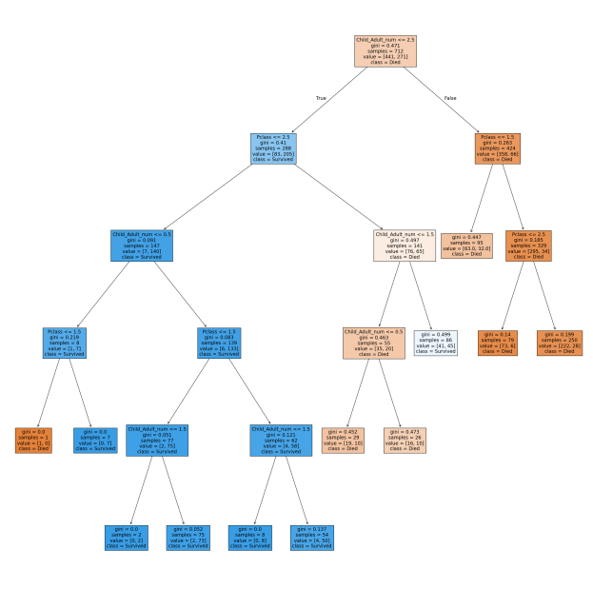

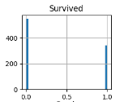
Decision Tree – Data Visualisation 1
Class and Child/Adult new feature only
not scaled, training data 80/20 test split
Gini default model – accuracy 79%
Child or Adult Female
Adult male
Confusion Matrix
Pred Die Pred Live
Act (0) Died ([[0.88, 0.12],
Act (1) Lived [0.347, 0.66]])
1st or 2nd class
3rdclass
2nd or 3rd class
- 88% of the time will predict person died correctly
- 34.7 % of the time will predict person died when they survived
- 12% of time will predict someone lived when they died
- 66.5% of the time will predict person survived correctly
1st class

Slide 4
Decision Tree – Data Visualisation 2
Child or Adult Female
Adult male
1st or 2nd class
3rdclass
2nd or 3rd class
1st class
Female child
male child and adult female
Female and male child
adult Female
2nd
3rd
1st class
2nd
1st class
2nd
FC
MC
Prediction (712 people)
All adult males die
All female adults live
84 children total
1 1st class female child dies
All 55 3rd class children die
MC
FA
MC
FA

Slide 5
Classifier Models compared
All 80/20 test split of training data
Comparable confusion matrix for most except Sigmoid and Bernoulli NB
K = 3 KNN model gives better prediction of survivors
Due to imbalanced dataset models not as good at predicting those that survived
60 % accuracy BeronulliNB couldn’t predict anyone living
Model | Logistic regression | KNN |  | SVM |  |  | Decision Tree |  |  | Naive Bayes
Features | Class, Child/Adult, Fare bucket |  |  |  |  |  |  |  | Class, Child/Adult | Class, Child/Adult, Fare bucket
Scaling | Robust |  |  |  |  |  |  |  | none
Other conditions |  | k = 3, error ~0.197 | k = 9, error ~0.18 | linear | sigmoid | rbf | gini/ entropy | gini with max depth | gini/ entropy /g with max depth | Gaussian | Multinomial | Bernoulli
Accuracy % | 77 | 82 | 82 | 82 | 51 | 80 | 82 | 81 | 79 | 73 | 69 | 60
predict person died correctly (pink add to 100) % | 88 | 87 | 94 | 91 | 61 | 91 | 94 | 90 | 88 | 83 | 77 | 100
predict person died when they survived (blue add to 100) % | 39 | 27 | 35 | 31 | 64 | 37 | 35 | 32 | 34 | 42 | 45 | 100
predict someone lived when they died (pink add to 100) % | 12 | 13 | 6 | 9 | 39 | 9 | 6 | 10 | 12 | 17 | 22 | 0
predict person survived correctly (blue add to 100) % | 61 | 73 | 65 | 69 | 35 | 63 | 65 | 67 | 66 | 58 | 55 | 0
Comments |  |  |  |  | Proxy for neural networks |  |  |  | *gini presented | Bernouilli for binary data, Multinomial for discrete counts s (doesn't like negative values of scaled data), Gaussian assumes norm dist *tried text data but errored

Slide 6
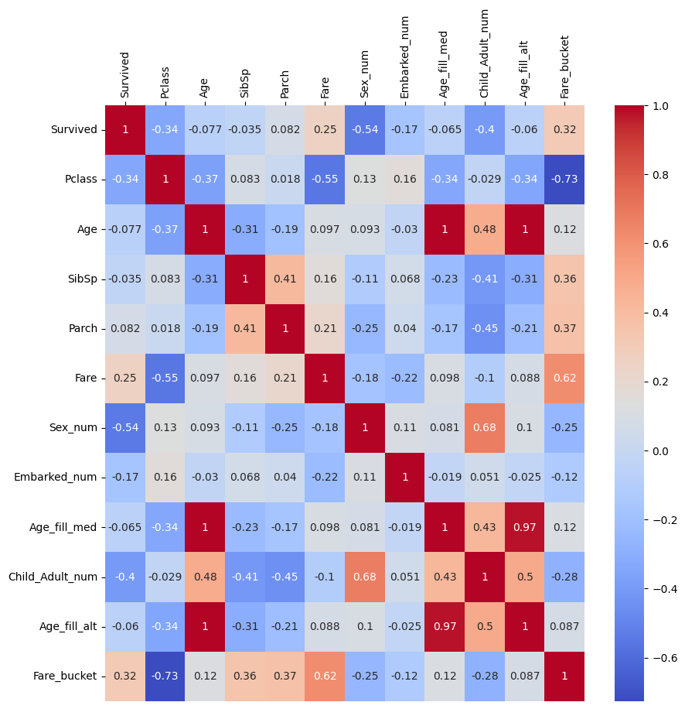
Feature Correlation
Fare qbucket and Child/Adult encoded (new features purple), used instead of Fare and Sex encoded (original orange) :
Have a stronger correlation than original variable with sibling/spouse, parent/child relationships and age
Haven’t incorporated the port that passengers embarked from but only weak correlations to everything

Slide 7
Conclusion
A simple unoptimised decision Tree predicts that all adult males die, all adult females live, all 3rd class children die
Models 80+/-3% accuracy with comparable confusion matrix except:
SVM sigmoid
Naive Bayes, particularly Bernouli
As per competition 100% accuracy possible if model all training data and fit test data (not used in modelling)
Further refinement of models and features

